Slide 1
TechReady’s Innovation Sub-Steps Analysis for Blockholders to Evaluate Key Areas of Technology Development to Prioritize.
Presented By
BIBEK LAMSAL

Slide 2
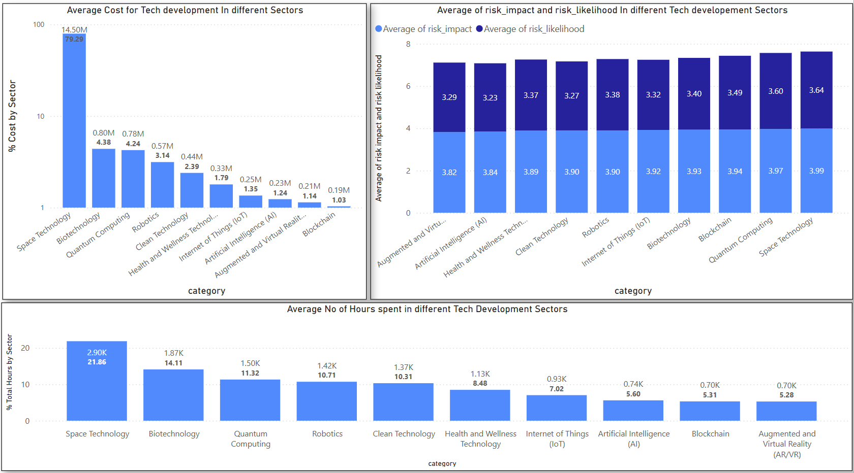
Visualization using dashboard

Slide 3
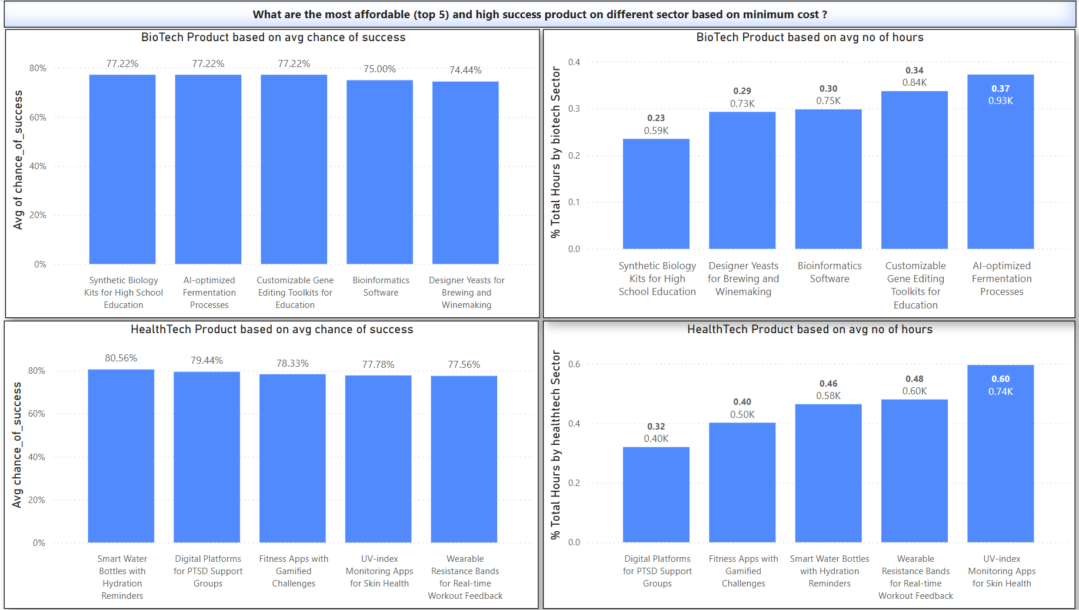

Slide 4
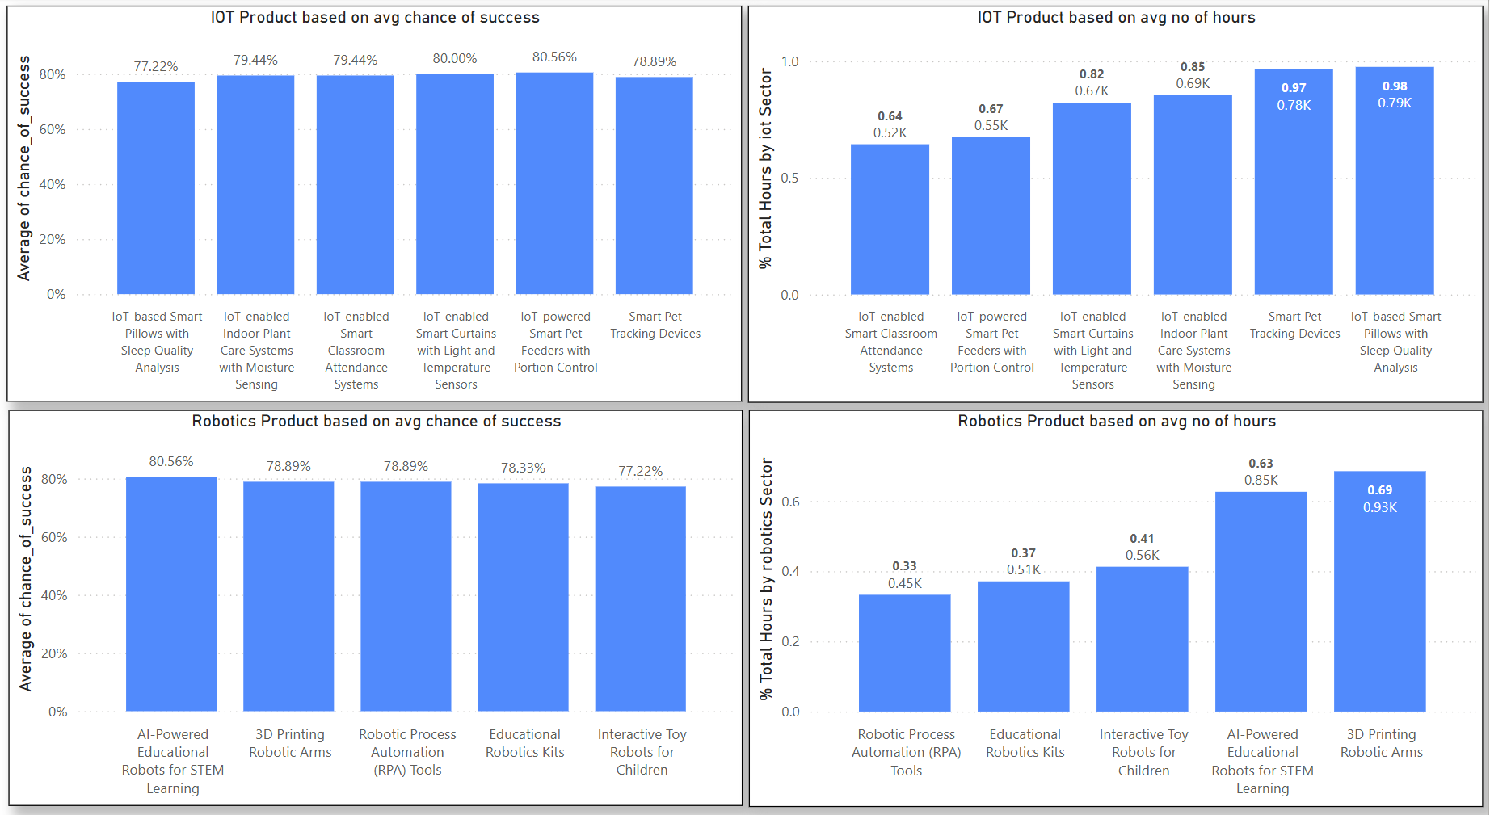

Slide 5
Innovation dashboard insights report
1. Space Technology Dominates Cost & Time :
It consumes over 79% of total cost and avg. ~2.9K hours — a high-risk/high-cost space, suited only for strategic or phased funding.
2. Biotech Offers Balanced High Success and Innovation :
Biotech products like CRISPR therapy and RNA-based vaccines deliver ~74%–77% success rates with reasonable cost and time inputs.
3. HealthTech is the Most Efficient Sector :
Devices like AI-powered cancer detectors and smart hearing implants combine ~78% success rate with low hours (~2.1K or less) — ideal for fast, impactful deployment.
4. IoT Products Show High Success at Low Cost :
Products like Smart Farming Systems and IoT-enabled Sensors achieve >77% success with <1K hours, offering high scalability.
5. Robotics Sector Has Consistent ROI Potential :
Educational and assistive robotics show ~78–80% success with modest effort (~0.9–1.3K hours) — strong candidates for mass-market testing.

Slide 6
RecommEndation
Prioritize HealthTech & Biotech: Best blend of affordability, low risk, and high product success. Ideal for short-term returns.
Support IoT in Education & Smart Living: Mid-level investment, but strong success (esp. in smart classrooms, pets, and curtains).
3. De-risk Investment in Space Tech & Quantum: High risk and high cost – suitable only for long-term, well-funded innovation programs.

Slide 7

Call To Action
Let’s meet with TechReady Innovation Support team to brainstorm how to expand the use of IoT Product in Education and smart classrooms.

